Slide 1
CEC3
Combined MS/HS Meeting
Nov 6, 2024

Slide 2
What is CEC3?
One of 32 Community Education Councils (CECs) in New York City.
Elected parent volunteers represent public elementary and middle schools in School District 3
CEC 3 holds monthly meetings and contributes to shaping educational policy in District 3.
Responsibilities include:
  Approving school zoning lines
  Holding hearings on the capital plan
  Evaluating community superintendents
  Providing input on other important policy issues

Slide 3
Upcoming CEC Meetings
Nov. 12, 6:30 pm on Zoom MS Committee - Parents Helping Parents
  Middle School Applicants Hear from Parents of Current Middle Schoolers in D3
Nov. 19, 6:30 pm on Zoom & In person at WESS - Business & Calendar Mtg.
Visit CEC3.org for more info

Slide 4

Nov. 13th
6-8 pm
Joan of Arc
Application Deadline Dec 20, 2024

Slide 5
Agenda
Overview Middle School & High School Process & Recent Changes
Middle School and High School options
Changes in D3
  New 6-12 middle school/high school IB program and new building for Mott Hall II
  New building for West Prep Academy
Useful Links to Information and Data
Feedback from parents for CEC3?

Slide 6
High School Admissions
https://www.schools.nyc.gov/enrollment/enroll-grade-by-grade/high-school

Slide 7
High School Admissions Process
Go to MySchools.nyc
  Make sure your applicant info is correct
  Find your Random Number
  Research programs and their specific requirements for admission
  Go to Open Houses
  Add schools and programs to your application in your true order of preference
  Apply by December 4th
  Offers released Thurs. Mar. 6th

Slide 8
High School Admissions - Changes in 2024
No limit to application choices
  List any number of choices, not just twelve
Chances of offer feature in the HS application on MySchools
  Indicates whether applicants have a high, medium, or low chance of receiving an offer, based on the applicant’s admissions characteristics like grades, priority group, etc.
Additional 6 schools now offer priority to Manhattan residents for 75% of their seats.
  Eleanor Roosevelt High School, Millennium High School, The Clinton School, NYC Lab School for Collaborative Studies, Baruch College Campus High School, New York City Museum School
Notes:
Eleanor Roosevelt is in Upper Manhattan on the East Side, the rest of the 6 schools that offer priority are in lower Manhattan.

Slide 9

High School Admissions - So Many Options!
Over 400 high schools in NYC with over 700 programs!
Combined Middle/High Schools (6-12)
Career and Technical Education Programs
Community Schools
Transfer Schools
Early College Schools
Early College and Career Schools
Performance Assessment Schools
Schools for New Arrivals
Autism NEST programs
ACES - Academic Career and Essential Skills programs
Plus
Specialized High School Test SHSAT Schools (9-12)
Hunter College High School HCHS (7-12)

Slide 10
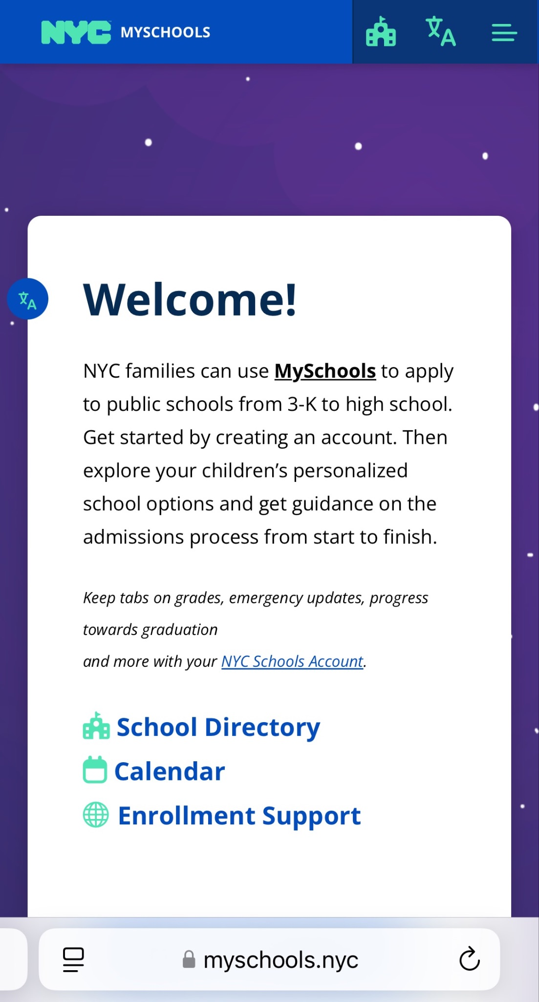
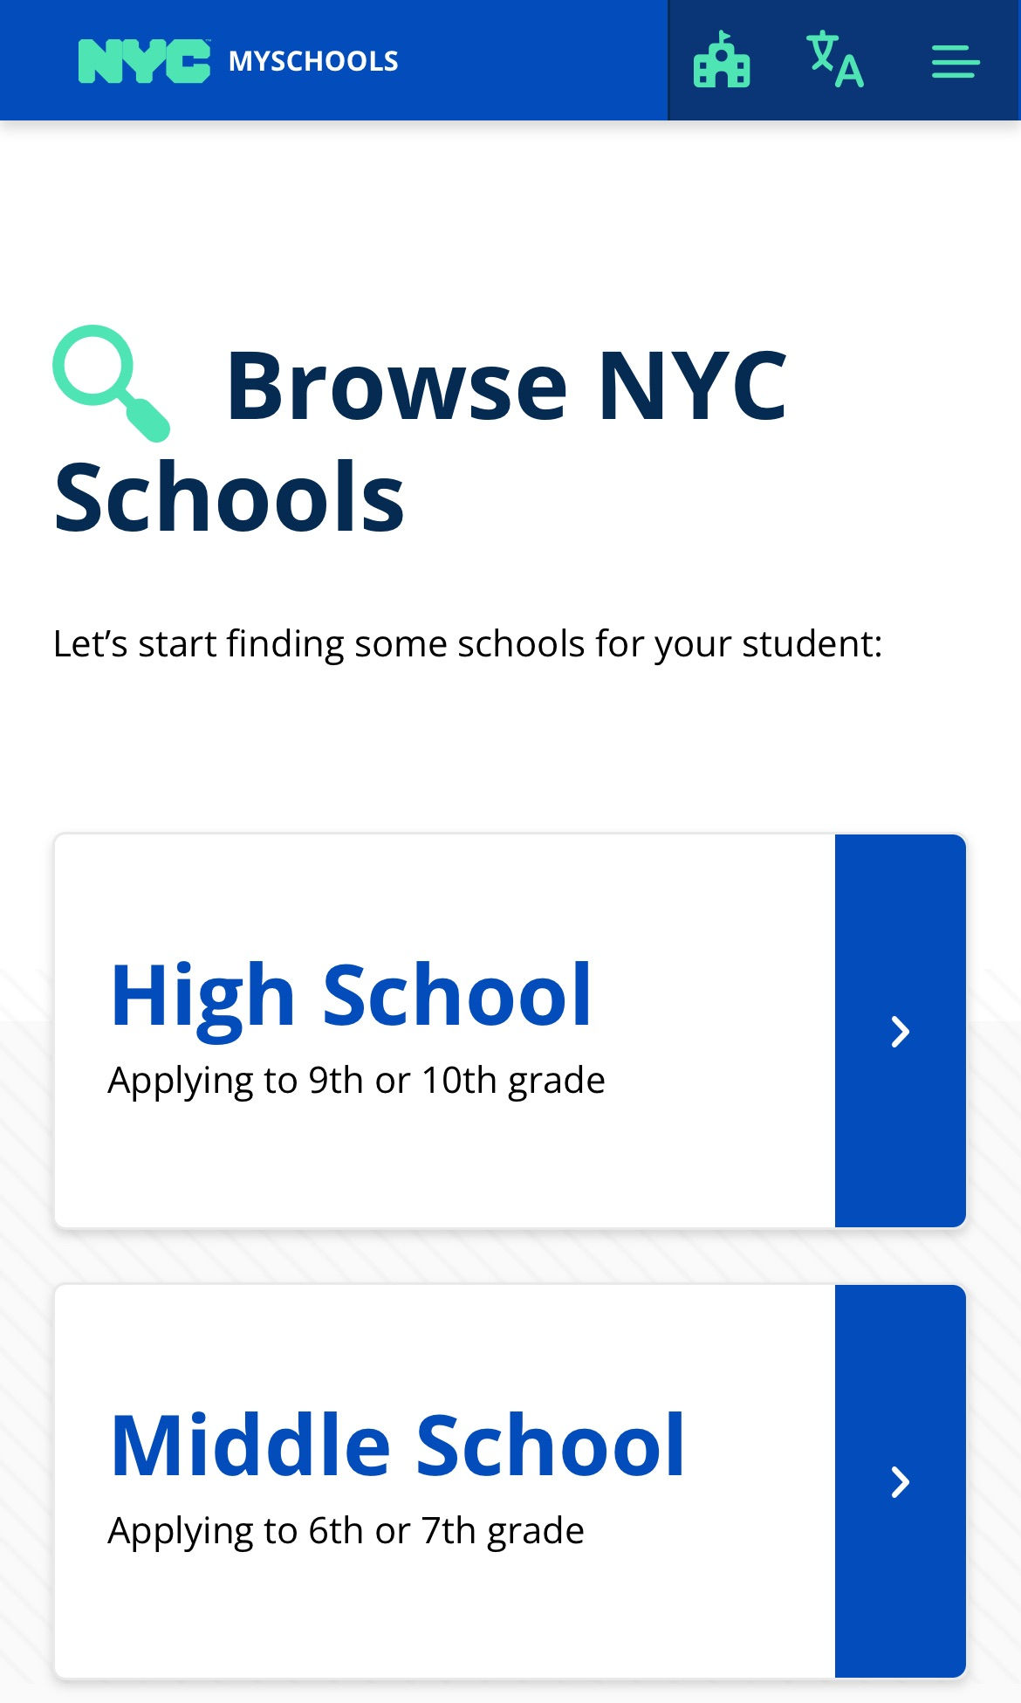
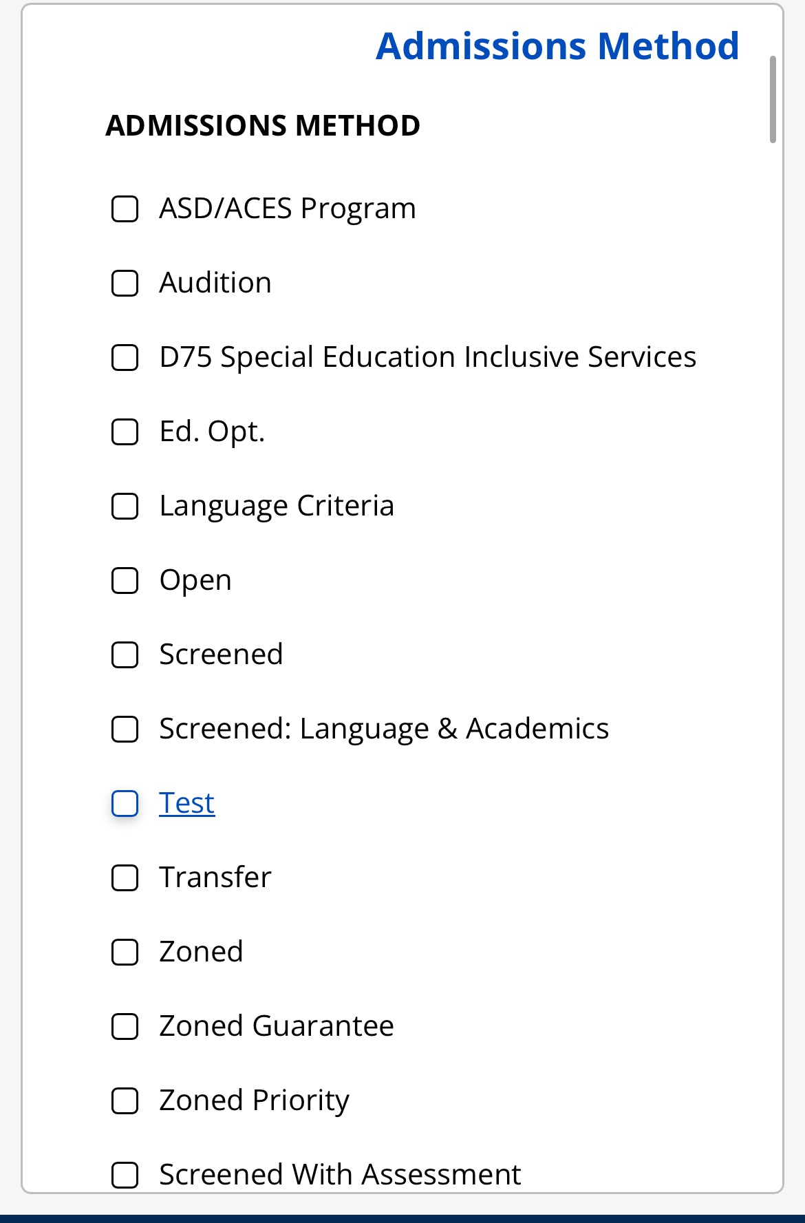
MySchools.nyc

Slide 11
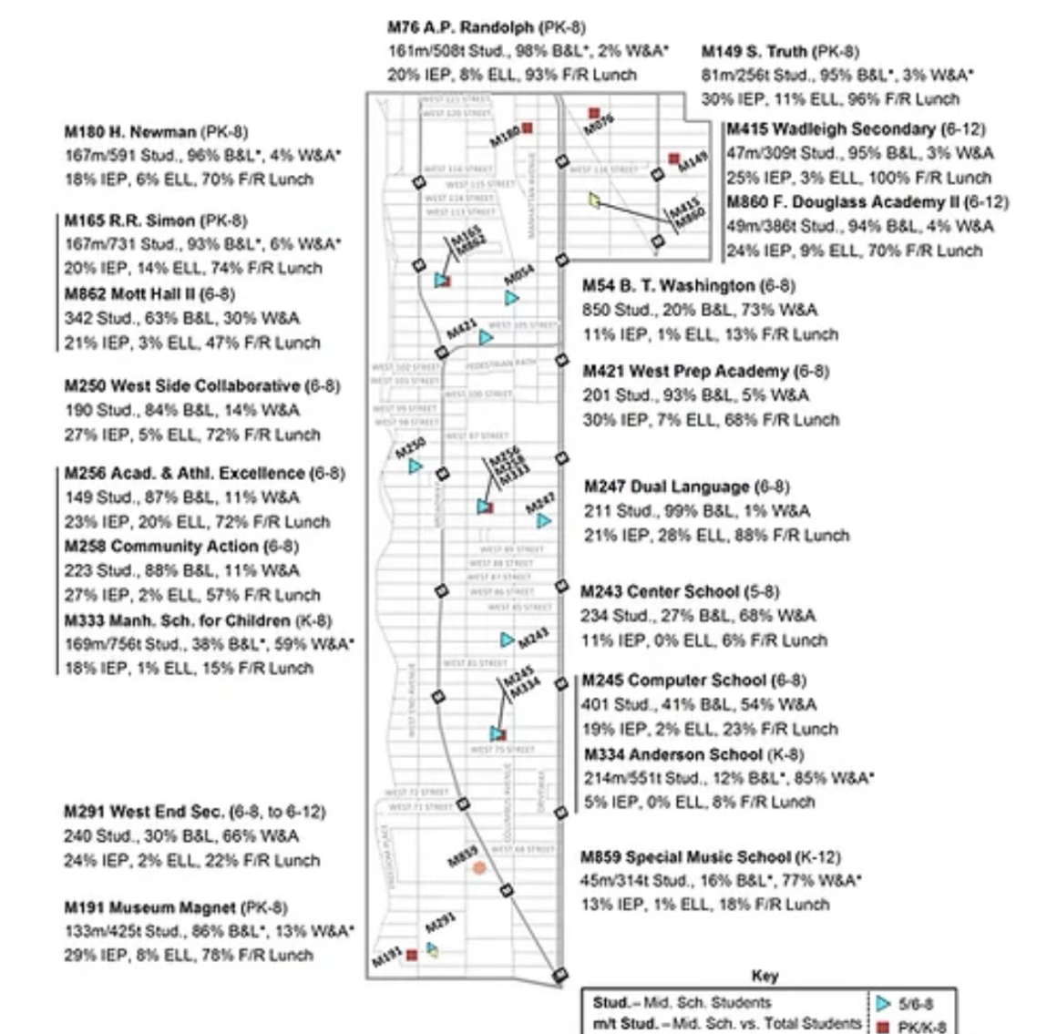
High Schools in D3 Borders*
M415 Wadleigh Secondary School for the Performing & Visual Arts (6-12)
M860 Frederick Douglass Academy II (6-12)
M610 Young Women’s Leadership School (6-12)
Brandeis Campus Schools:
M402 UA for Green Careers
M403 Global Learning Collab.
M404 Innovation Diploma Plus
M417 Frank McCourt HS
MS 76 Mott Hall II (6-12)
Proposed HS expansion
MLK Campus Schools:
M299 Maxine Greene HS
M307 UA School for Media Studies
M492 HS Law, Advocacy
M494 HS for Arts & Technology
M541 Manhattan Hunter Science
M859 SMS (K-12)
Laguardia HS
M291 WESS (6-12)
*District 3 HS, Manhattan HS District, CUNY & UA School District, New Visions School District, Citywide Transfer School District
Notes:
D3 schools under superintendent Kamar Samuels - Mott Hall II, SMS, WESS. Manhattan HS District Schools under Supt. Gary Beidleman - in green, CUNY & UA School District under Supt. Fred Walsh, New Visions for Public Schools School District under Supt. Noah Angeles - In Teal, Citywide Transfer School District - in purple, Acting Supt. John Sullivan

Slide 12
High School Admissions - Admissions Methods
Open Admissions - Selection By Random Number & Applicant Ranking
  Offers made based on assigned random numbers that can be found in MySchools accounts.
Screened Selection - By Tier, Rank
  Educational Option Schools reserve seats in High, Medium, Low GPA groups.
  Screened Schools admit students in priority order by GPA Tiers 1-4
  Screened Schools Plus Assessment Schools admit students by GPA Tiers 1-4 plus another assessment
  Audition Schools rank students for admissions based on selection criteria - audition, essay, portfolio, etc.
Test - Hunter College High School Admissions (HCHS) Test & SHSAT Test
  Offers are made based on performance on an exam
  SHSAT Schools - Eligible students may participate in DREAM program, Discovery Program
  HCHS - Students who just missed the cutoff to sit for the test can fill out Academic Insights Profile

Slide 13
Seats for Students With Disabilities
Open Admissions & Screened Schools Reserve Seats for General Education Students (GE) and Students With Disabilities (SWD)
  Specialized schools have one applicant pool with no reserved seats.
SWD seats are for students who receive special education instructional programming for >20% of their instructional program on their current IEPs.
Related services such as speech, OT, & PT are NOT considered special education programming for the purposes of High School admissions.
Students with a 504 plan who do not receive >20% of instructional programming through an IEP plan do not qualify for SWD seats.
SWDs must meet the same admissions criteria as non-disabled peers.
All accessible middle and high schools prioritize students with accessibility needs.

Slide 14
Priority
Diversity in Admissions (DIA) Programs Reserve Seats for a % of Students Who Qualify for Free or Reduced Price Lunch (FRPL).
Some schools give priority to students who attend an Open House or Admissions event.
Some schools give priority for students who live or go to school in Borough.
Some schools give priority to continuing students from a middle school program.

Slide 15
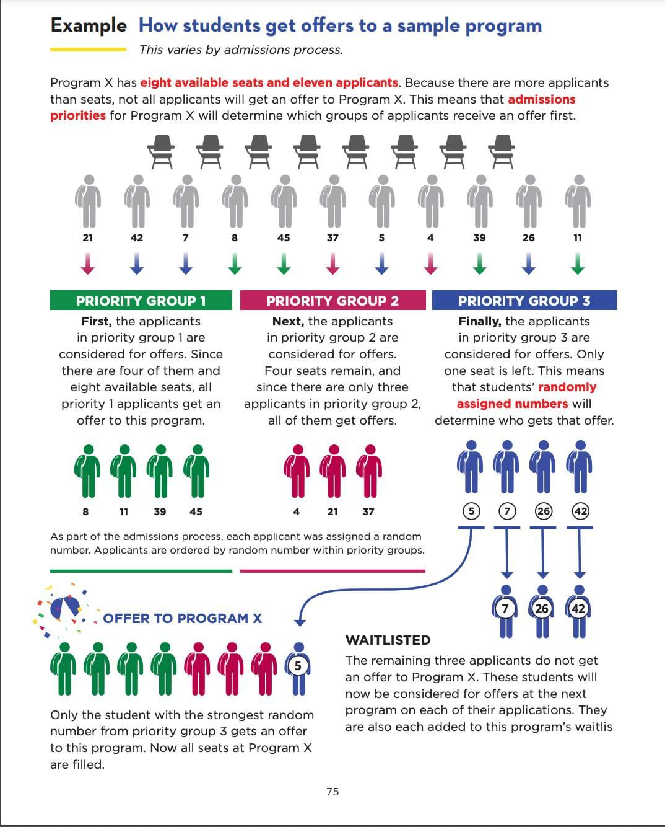

Slide 16
Random Numbers
A long string of letters and numbers, for example: B51920AF-F1C6-40EC-8E9A-3E1E50CB13BB.
Used to determine the order in which students are matched to schools during admissions.
Sorted in numeric and then alphabetical order like this: 0, 1, 2 ... 9, A, B, C, D, E, F.
For example, when the following two random numbers are sorted, the number that begins with “5” comes first:
5B1920AF-F1C6-40EC-8E9A-3E1E50CB13BB
B51920AF-F1C6-40EC-8E9A-3E1E50CB13BB
https://vimeo.com/502638163

Slide 17
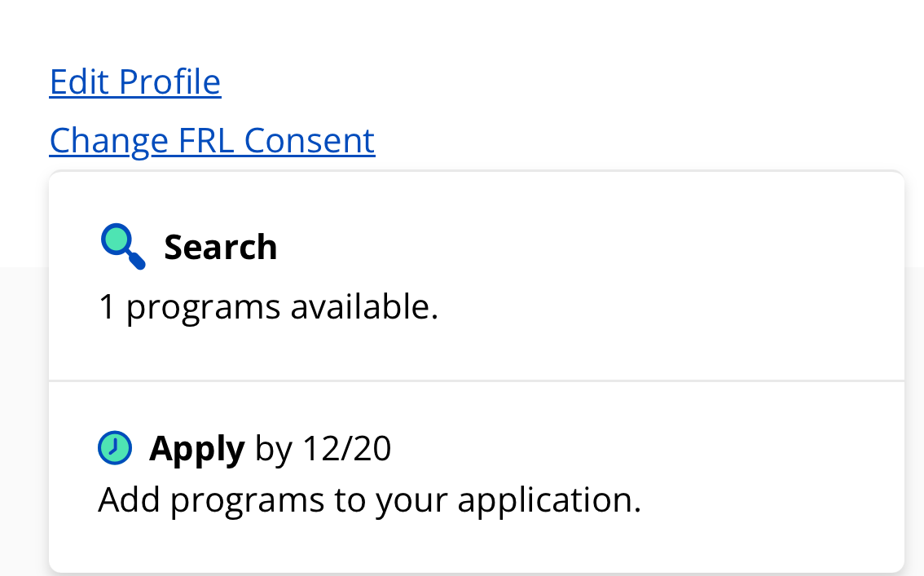
How to Find Random Number
Check MySchools.nyc
Sign into your account
Click on Edit Profile and scroll down

Slide 18
How to Find Random Number
Check MySchools.nyc
Sign into your account
Click on Edit Profile and scroll down

Slide 19
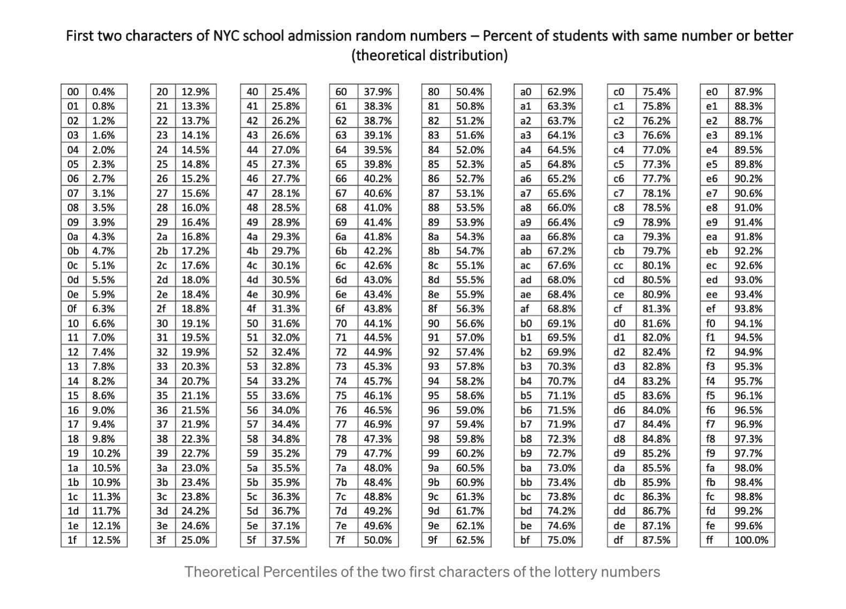
HS & MS Admissions - Interpreting Random Numbers

Slide 20
HS & MS Admissions - Interpreting Random Numbers
Created by a public school parent, not DOE

Slide 21
Open Admissions HS - Manhattan
10 High Schools/Programs in Manhattan Admit Students by Open Admission
Mott Hall 05M304 Harlem Students: 207 | Harvest Collegiate HS 02M534 Union Sq DIA Priority 63% | Academy for Software Engineering 02M546 Gramercy Students: 412 DIA priority 69% | Essex St. Academy 02M294 Chinatown Students: 353 Consortium School DIA Priority 50% | Urban Assembly New York Harbor School (9-14) Marine Science & Technology Program 02M551 Governors Island Students: 513 DIA Priority 69%
A School Without Walls: Hybrid Pathway 02M395 | Murray Bergtraum HS for Business Careers The 9th Grade Academy 02M520 Students: 130 | Hudson HS of Learning Technologies 02M437 Chelsea Students: 367 Priority to Manhattan Students | Eagle Academy for Young Men of Harlem (6-12) 05M148 Eagle Early College Students: 325 Priority to Manhattan Students | Frederick Douglass Academy (6-12) Harlem Samba Program 05M499 Harlem Students: 994

Slide 22
High School Admissions - Educational Option Programs
Most HS in Manhattan - 71 programs at 57 schools
Ed Opt Programs - admit across Low, Medium, High academic categories
Low
⅓ of Seats
GPA < 77.5
Med
⅓ of Seats
GPA 77.5- 88.33
High
⅓ of Seats
GPA 88.33 or Above

Slide 23
Educational Option Schools in D3 & D5
Urban Assembly School for Green Careers 03M402 Students: 307 Priority to Manhattan students or residents | Global Learning Collaborative 03M403 UWS Students: 464 Priority to Manhattan students or residents | HS for Law Advocacy & Community Justice 03M492 Lincoln Sq. Students: 401 Early College Program HS Program | HS for Arts & Technology 03M494 Lincoln Sq. Students: 457 | Urban Assembly School for Media Studies 03M307 Lincoln Sq. Students: 372
Frederick Douglass Academy II (6-12) The Douglass STEM Institute 03M860 Harlem Students: 336 Priority to Continuing 8th Graders | Urban Assembly School for Global Commerce 05M151 Students: 195 Priority to Manhattan students & residents | Urban Assembly School for the Performing Arts 05M369 Manhattanville Students: 386 | Eagle Academy for Young Men Harlem (6-12) 05M145 Harlem Students: 325 Priority for Continuing 8th Graders, Then Manhattan students or residents. | Frederick Douglass Academy (6-12) World Language 05M499 Harlem Students: 994

Slide 24
High School Admissions - Screening by Tier
Screened Admissions - Tiers Based on 7th Core Course Grades for 9th Grade Admission, 8th Grade Core Course Grades for 10th Grade Admission.
  ELA, Math, Social Studies, & Science
Citywide Cutoffs
  Tier 1 - Students with GPAs in the top 15% of the city (94.25) or at their school (varies)
  Tier 2 - Students with GPAs in the top 30% of the city (89.75) or at their school (varies)
  Tier 3 - Students with GPAs in the top 50% of the city (82.75) or at their school (varies)
  Tier 4 - Students with GPAs in the top 70% of the city (76.25) or at their school (varies)
Click on Edit Profile in MySchools.nyc to view your students Tier #
  Cutoffs at different middle schools vary and may be different than the citywide cutoff

Slide 25
Screened Schools in Manhattan - By GPA
Baruch 02M411 Chelsea/Union Sq. Students: 486 75% of seats reserved for Manhattan students. DIA Priority for 66% of seats | Eleanor Roosevelt 02M416 Lenox Hill/UES Students: 541 Core Course Grades 75% of Seats Reserved for Manhattan students DIA Priority for 50% of Seats | NYC Lab School for Collaborative Studies 02M412 Chelsea/Union Sq. Students: 462 75% of seats reserved for Manhattan students | Millennium HS 02M418 Lower Manhattan Students: 665 75% of seats reserved for Manhattan students. | Museum School 02M414 Chelsea/Union Sq. Students: 483 75% of Seats Reserved for Manhattan Students. DIA Priority for 50% of seats.
The Clinton HS (6-12) 02M260 Chelsea/Union Sq. Students: 504 (HS) 75% of seats reserved for Manhattan students. | Thurgood Marshall Academy for Learning & Social Change (6-12) 05M670 Priority to continuing 8th graders, then D5 residents, then Manhattan students | Columbia Secondary School (6-12) 05M362 Morningside Heights Students: 401 (HS) Priority to continuing 8th graders, D3 Residents above 96th street, D4, D5, D6 Residents | West End Secondary School (6-12) 03M291 Lincoln Sq, UWS Students: 603 Priority for continuing 8th graders DIA Priority for HS 60% MS Open Admissions | Mott Hall II (6-12) 03M862 Harlem Students: 360 (MS) Expanding from 6-8 to 6-12, pending PEP vote. Priority to continuing 8th graders. MS Open Admissions

Slide 26
Screened Schools in Manhattan - By GPA
Young Women’s Leadership School (6-12) 03M610 Manhattan Valley Students: 136 | HS for Environmental Studies Honors Program 02M400 W. 56th St. Students: 1075 | Frederick Douglass Academy (6-12) Dual Enrollment/AP STEM 05M499 Harlem Students: 994 | City College Academy of the Arts (6-12) 06M293 Inwood Students: 340 (HS) | A Phillip Randolph Campus HS Engineering, Medicine, Humanities Programs Hamilton Heights Students: 1505
Park East HS 04M495 East Harlem Students: 386 | Manhattan Center for Science & Mathematics 04M435 East Harlem Students: 1629 | Humanities Preparatory Academy 02M605 Chelsea Students: 261 | Manhattan Village Academy Chelsea/Union Sq. Students: 430 | High School for Health Professions & Human Services Science & Research 02M420 Stuytown Students: 1780
Central Park East HS 04M555 East Harlem Students: 520 | Chelsea Career & Technical Ed. HS 02M615 SOHO Students: 422 | The American Sign Language & English Secondary School 02M047 Kips Bay Students: 222

Slide 27
Manhattan Screened Schools GPA + Assessments/Other
Bard HS Early College Manhattan 01M696 Lower East Side Students: 565 BHSEC Assessment 30% Humanities Response, 30% Math Portion, 30% Interview, 10% Grades | Frank McCourt HS 03M417 UWS Students: 421 20% Grades, 80% Interview/Online Form | Gramercy Arts HS (02M374) Gramercy/Union Sq Students: 508 Capstone Program Ranked by Grades & Essay | NYC i-School (02M376) SOHO-Tribeca Students: 452 100% Online Admissions Activity
NEST+M (K-12) (01M539) Lower East Side Students: 620 (HS) 50% Grades, 50% Online Admissions Activity | Manhattan Hunter Science HS (03M541) Lincoln Sq/ UWS Students: 476 70% Grades, 30% Essay | High School for Dual Language & Asian Studies (02M545) East Village Students: 403 Admissions by grades & dual language proficiency | Manhattan Bridges HS (02M542) Hell’s Kitchen Students: 514 Admissions by grades & spanish dual language

Slide 28
Screened Schools - Consortium Schools
Consortium Schools allow students to graduate using Performance Based Assessment Tasks (PBATs) instead of the Regents exams.
Some have no essays or assessments for admissions.
5 consortium schools use the same essay assessment that can be completed once and submitted to all schools through MySchools.nyc
Beacon Midtown W./Hell’s Kitchen Students: 1456 20% Grades, 80% Essay | E Side Community HS Lower East Side Consortium School Students: 389 100% Essay | Institute for Collaborative Ed. (6-12) Stuytown Students: 280 (HS) 100% Essay (HS) DIA 50% (MS) | School of the Future (6-12) Gramercy Students: 441 100% Essay | University Heights Secondary School Bronx Students: 50% Grades, 50% Essay

Slide 29
High School Admissions - Auditions, Portfolios, etc.
Virtual auditions - All schools offer, Upload to MySchools.nyc
In-person auditions - Some schools offer, check school’s website to sign up.
Common audition components - can use the same audition for multiple programs.
Programs score auditions & students are admitted in descending score order.
Academic records are not used at programs with an audition admissions method
  Except Laguardia - must have at least 65 in each core course subject
https://www.schools.nyc.gov/enrollment/enroll-grade-by-grade/high-school/high-school-auditions

Slide 30

Audition Schools in D3 Borders
Special Music School (K-12)
Virtual or In-person auditions
Auditions for three concentrations
  Composition Concentration
  Instrumental Concentration
    piano, violin, viola, cello, double bass, guitar, flute, oboe, clarinet, bassoon, saxophones trumpet, French horn, trombone, euphonium/baritone, tuba and percussion.
  Vocal Concentration
More openings in HS than MS
District 3 School, Supt. Kamar Samuels

Slide 31

Audition High Schools in D3 Borders
Wadleigh Secondary School for the Performing & Visual Arts
Virtual or In-Person Auditions
Admits students by audition in one of the following areas:
  Dance
  Instrumental Music
  Theater Arts
  Visual Arts
  Vocal Music
Part of New Visions Public School District, Supt. Noah Angeles
wadleigharts.org

Slide 32

Audition Schools in D3 Borders
Laguardia High School
Virtual Auditions Only
Must have GPA of 65 or equivalent in each core subject in last school year.
6 studios - applicants w/ qualifying scores in >1 studio may receive multiple offers.
  Dance
  Drama (Theater)
  Instrumental Music
  Technical Theater
  Vocal Music
Manhattan HS District, Supt. Gary Beidleman
https://www.laguardiahs.org/

Slide 33
Other Audition Schools in Manhattan
Gramercy Arts High School (02M374)
Professional Performing Arts High School (02M408)
Talent Unlimited (02M519)
Repertory Company High School for Theatre Arts (02M531)
The High School for Fashion Industries (02M600)
Art and Design High School (02M630)
https://www.schools.nyc.gov/enrollment/enroll-grade-by-grade/high-school/high-school-auditions

Slide 34
High School Admissions Process - SHSAT
For 8th & 9th Grade Applicants to SHSAT Schools
  Register to take the SHSAT exam by Oct. 18 in MySchools.nyc
  Research the 8 SHSAT Schools:
    Bronx Science, Brooklyn Latin, High School for Mathematics, Science and Engineering (HSMSE), High School of American Studies at Lehman College, Queens High School for the Sciences at York College, Staten Island Technical High School, & Stuyvesant.
  Add SHSAT Schools to your SHSAT registration application in true order of preference
  Exams administered for 8th Grade Oct. 30, Nov. 16-17; For 9th Grade Dec. 7-8
  Offers are made in descending SHSAT score order until all seats are filled.

Slide 35
High School Admissions - Hunter College High School
For 6th Grade Applicants to Hunter College High School HCHS (7-12)
  Eligibility requirements:
    Must be in 6th grade and reside in NYC at the time of application
    Must have achieved min. qualifying score on 5th grade state tests (474 ELA, 496 Math) or on other nationally recognized tests (ISEE, ITBS, ERB, NWEA MAP, Stanford 10, Terranova).
    New this year - Students who narrowly missed the eligibility cutoff may fill out an academic insights form that will be posted on the HCHS website on Nov. 8th. Academic insights forms will be reviewed after the Dec. 6th application deadline and those who filled it out may be invited to sit for the exam depending on space availability at testing sites.
    To Apply, go to www.ravenna-hub.com, create an account, and register for the exam.
  Applications open now, Due Friday Dec. 6, 2024
  HCHS Test will be administered on January 24, 2025

Slide 36
What are the odds of admission?
Demand
  Check # applicants per seat in MySchools.nyc
  There are seats for General Education GE Applicants and Students With Disabilities SWD
GPA
  Check your students Priority Group or Ed Opt High/Medium/Low Category in MySchools.nyc
  Make sure that your child’s Grades were entered correctly
Residency priority
  Make sure your address is listed correctly in MySchools.nyc
Diversity In Admissions (DIA) programs
  Make sure you have filled out the school lunch form and are listed as qualifying for Free or Reduced Priced Lunch if applicable
Lottery Number
  Check your child’s lottery number in MySchools.nyc
Ranking of audition, essay, or portfolio or performance on an exam
  Make sure you know the requirements for each school, register for any assessments/auditions.
  Submit auditions, essays, portfolios online at MySchools.nyc.

Slide 37
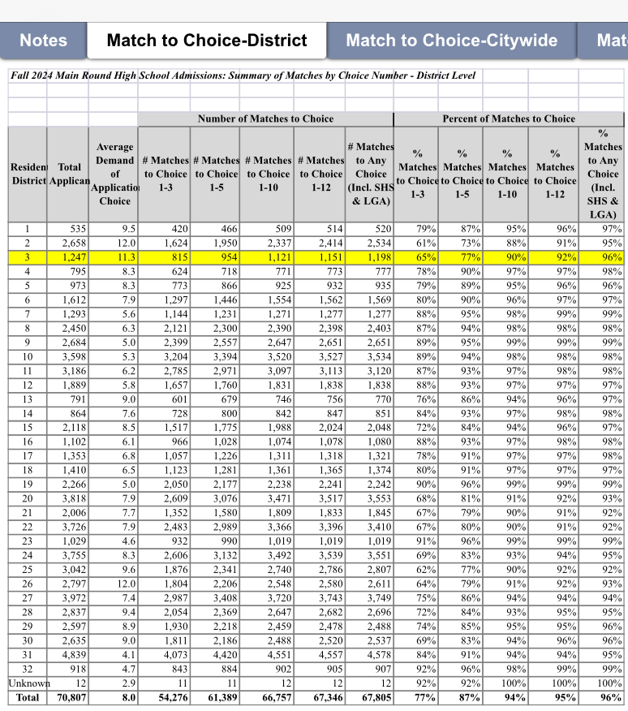
Fall 2024 HS Outcomes
65% of D3 Students matched to one of their top 3 choices.
77% of D3 Students matched to one of their top 5 choices.
90% of D3 Students matched to to one of their top 10 choices.
92% of D3 Students matched to one of their 12 choices.
96% of D3 Students matched to any choice (Incl. SHS & LGA).
Infohub@nyced.org - Admissions Outcomes

Slide 38
High School Admissions - Important Dates
Tuesday, October 1, 2024: High School Application, LaGuardia Application, and Specialized High Schools Admissions Test (SHSAT) Registration Opens
Friday, October 18, 2024: SHSAT Registration Closes
Wednesday, October 30, 2024: SHSAT School Day Testing
Sat / Sun, November 16-17, 2024: SHSAT Testing (8th grade students not participating in school day testing)
Wednesday, December 4, 2024: High School and LaGuardia Applications Close
Sat / Sun, December 7-8, 2024: SHSAT Testing (9th grade students)
Thursday, March 6, 2025: High School Offer Release

Slide 39
High School Admissions - Important Dates
Tuesday, October 1, 2024: High School Application, LaGuardia Application, and Specialized High Schools Admissions Test (SHSAT) Registration Opens
Friday, October 18, 2024: SHSAT Registration Closes
Wednesday, October 30, 2024: SHSAT School Day Testing
Sat / Sun, November 16-17, 2024: SHSAT Testing (8th grade students not participating in school day testing)
Wednesday, December 4, 2024: High School and LaGuardia Applications Close
Sat / Sun, December 7-8, 2024: SHSAT Testing (9th grade students)
Thursday, March 6, 2025: High School Offer Release

Slide 40
Middle School Admissions
https://www.schools.nyc.gov/enrollment/enroll-grade-by-grade/middle-school

Slide 41
Middle School Admissions Process
Go to MySchools.nyc
  Make sure your applicant info is correct
  Find your Random Number
  Research programs and their specific requirements for admission
  Go to Open Houses
  Add schools to your application in your true order of preference
  Apply by December 20th
  Offers released Tuesday, April 8th

Slide 42
Middle School Admissions - D3 Schools
Open Admissions at all D3 Middle Schools - by random number.
Seats Reserved for General Education (GE) and Students With Disabilities (SWD)
Diversity in Admissions (DIA) Programs at all D3 Middle Schools
25% of seats reserved for students who qualify for FRPL
Exceptions:
*Special Music School - requires auditions, No DIA
*Anderson - students screened by 4th grade core course grades, No DIA

Slide 43
Middle School Admissions - Changes in 2024
May apply out of district
  Students living or going to school in the district have priority over out-of-district applicants
  Some schools outside of D3 are screened or require auditions.
  As always, Citywide Schools are open to all students across NYC and do not have district priority
List of Citywide Middle/High Schools (e.g. Quest to Learn, I.C.E., etc)
https://insideschools.org/insidetools/citywide-middle-schools

Slide 44
Middle School Admissions - Screened/Audition Schools
Some Schools Outside of D3 Use Screens/Auditions, For Example:
Columbia Secondary School (6-12) - 4th Grade Grades
Priority to students in District 6, 5, 4, & 3 above 96th street
Mark Twain I.S. 239 & Some District 21 Schools - Talent Tests (Register by Nov. 8)
Professional Performing Arts High School (6-12) - Auditions
Ballet Tech (4-8) - Auditions
NEST+M, TAG, Brooklyn School of Inquiry, 30th Avenue School - 4th grade grades
Hunter College High School (7-12) - 5th Grade State Exams, HCHS Admissions Test

Slide 45
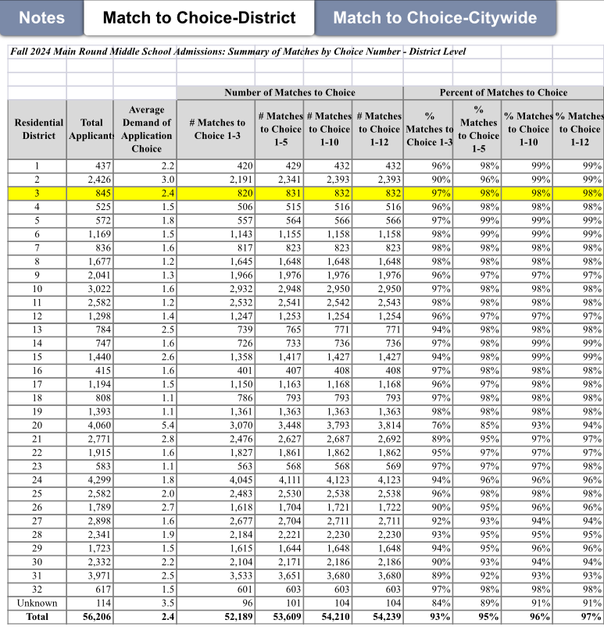
Fall 2024 MS Outcomes
97% of D3 Students matched to one of their top 3 choices
98% of D3 Students matched to one of their top 5 choices
Infohub@nyced.org - Admissions Outcomes

Slide 46
*New in D3* - Proposed Merger, Truncation, Re-siting
Truncation of grades K-5 of P.S. 76 A. Philip Randolph (03M076)
Re-siting of Mott Hall II (03M862) from building M165 to building M076
Merger of P.S. 76’s grades 6-8 with Mott Hall II
Expansion of Mott Hall II from grades 6-8 to grades 6-12 in the 25-26 SY
Re-siting of one site of elementary District 75 school, P.S. M226 (75M226), referred to as P226M@M076, from M076 to building M180 and co-location with P.S. 180 in the 2025-2026 school year
Truncation of grades 6-8 of P.S. 180 Hugo Newman (03M180) in the 25-26 SY

Slide 47
Upcoming Votes on the Proposals
The Panel for Education Policy will vote on the DOE’s merger, truncation, re-siting proposal at their December 4th meeting.
If the PEP votes for the proposals, they will take effect starting in the 2025-2026 School Year.

Slide 48
D3 Middle Schools*
PS 149 Sojourner Truth
MS 54 Booker T.
MS 256 Lafayette
MS 258 Community Action
MS 333 MSC
MS 243 Center
MS 247 Dual Language
MS 245 Computer
MS 334 Anderson
Proposed New Location for MS 862 Mott Hall II*
New Location for
MS 421 West Prep Academy
PS 859 Special Music School
MS 291 WESS
MS 191 RSMA

Slide 49
PK/K-8 Schools Now
PS 76* Proposed truncation & merger with Mott Hall II
PS 180* Proposed truncation from PK-8 to PK-5 & co-location with 75M226.
PS 149 Sojourner Truth
MS 333 Manhattan School for Children (MSC)
MS 191 The Riverside School for Makers & Artists (RSMA)

Slide 50
PK/K-8 Schools if Proposal Passes
PS 149 Sojourner Truth
MS 333 Manhattan School for Children (MSC)
MS 191 The Riverside School for Makers & Artists (RSMA)

Slide 51
5-8 Middle School
MS 243 Center School

Slide 52
6-8 Middle Schools
MS 54 Booker T.
MS 256 Lafayette
MS 258 Community Action
MS 247 Dual Language
MS 245 Computer
MS 862 Mott Hall II
New Location for
MS 421 West Prep Academy
PS 859 Special Music School
MS 291 WESS
MS 191 RSMA

Slide 53
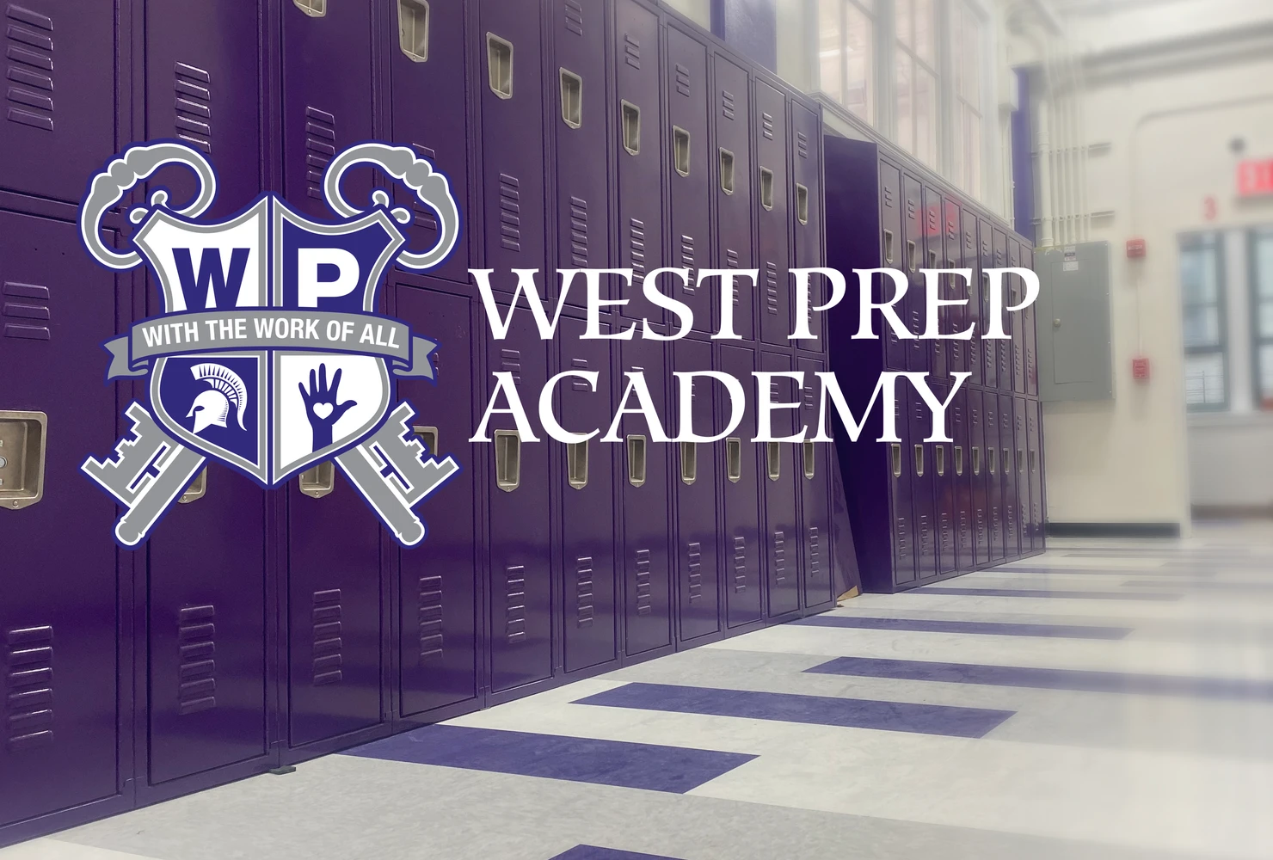
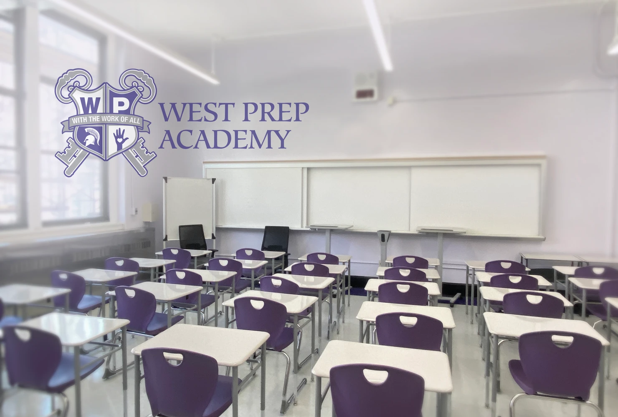
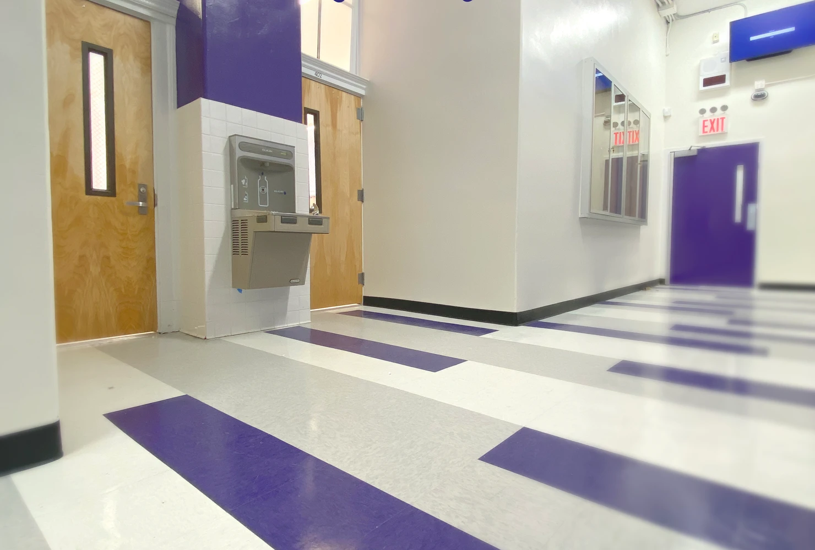
West Prep Academy - New Location in Ascension Building
New space on West 108th Street
New State of the Art Science Lab
New Collider Room: Sensory Space
New STEAM Room/Maker’s Space
New Dance Room
Updated Gym, Cafeteria, Auditorium
1:1 Devices for all students
Gen Ed & Autism Nest Programs
https://www.ms421.org/

Slide 54
Citywide/Specialized
PS 149 Sojourner Truth
MS 54 Booker T.
MS 256 Lafayette
MS 258 Community Action
MS 333 MSC
MS 243 Center
MS 247 Dual Language
MS 245 Computer
MS 334 Anderson (K-8)
MS 862 Mott Hall II
MS 421 West Prep Academy
PS 859 Special Music School (K-12)
MS 291 WESS
MS 191 RSMA

Slide 55
6-12 Schools*
PS 149 Sojourner Truth
MS 54 Booker T.
MS 256 Lafayette
MS 258 Community Action
MS 333 MSC
MS 243 Center
MS 247 Dual Language
MS 245 Computer
MS 334 Anderson
MS 862 Mott Hall II*
Current Location
in M165 building
MS 421 West Prep Academy
PS 859 Special Music Sc
MS 291 West End Secondary School (WESS)
MS 191 RSMA
District 3 6-12
Proposed District 3 6-12

Slide 56
6-12 Schools*
PS 149 Sojourner Truth
MS 54 Booker T.
MS 256 Lafayette
MS 258 Community Action
MS 333 MSC
MS 243 Center
MS 247 Dual Language
MS 245 Computer
MS 334 Anderson
MS 862 Mott Hall II*
Proposed Re-siting
in M076 building
MS 421 West Prep Academy
PS 859 Special Music School
MS 291 West End Secondary School (WESS)
MS 191 RSMA
District 3 6-12
Proposed District 3 6-12

Slide 57
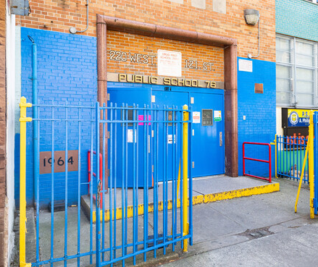
Mott Hall II M862
If the proposal passes the PEP vote:
Mott Hall II will be located in the M76 building
M76 middle school grades will merge with Mott Hall II
M76 K-5 Elementary School grades will be truncated
D75M226 will move from the M76 building to M180
Mott Hall II will add one grade per year, starting in the 2025-2026 school year, until it grows into a 6-12 school.

Slide 58

Mott Hall II M862
Mott Hall II offers an International Baccalaureate (IB) Program
IB Diploma Programme - challenging pre-university program that offers students an opportunity to earn college credit while in high school.

Slide 59
Proposed Re-Zoning of D3 Harlem Elementary Schools
Office of District Planning (ODP) & the Superintendent’s Office has been meeting with the Harlem Working Group and the CEC for over a year, discussing a proposed truncation of PS76, merger with Mott Hall II, and rezoning of elementary schools in Harlem.
ODP presented a rezoning plan at our Sept. & Oct. CEC3 meetings.
  Harlem would have one shared zone for all elementary schools.
  Proposal reflects feedback from the Harlem Working Group and Elementary School SLTs.
If the PEP votes for the Merger, Re-siting, Truncation proposal in December, CEC3 will vote on the rezoning plan in January.

Slide 60
Middle School Admissions - Important Dates
October 15, 2024: Middle School Application Opens (after school hours)
November 8, 2024: Deadline to register to test for Mark Twain I.S. 239 (21K239) and District 21 Talent Tests
December 20, 2024: Middle School Application Closes
April 9, 2025: Middle School Offer Release

Slide 61
Middle School Admissions - Important Dates
October 15, 2024: Middle School Application Opens (after school hours)
November 8, 2024: Deadline to register to test for Mark Twain I.S. 239 (21K239) and District 21 Talent Tests
December 20, 2024: Middle School Application Closes
April 9, 2025: Middle School Offer Release

Slide 62
Links to School Data

Slide 63
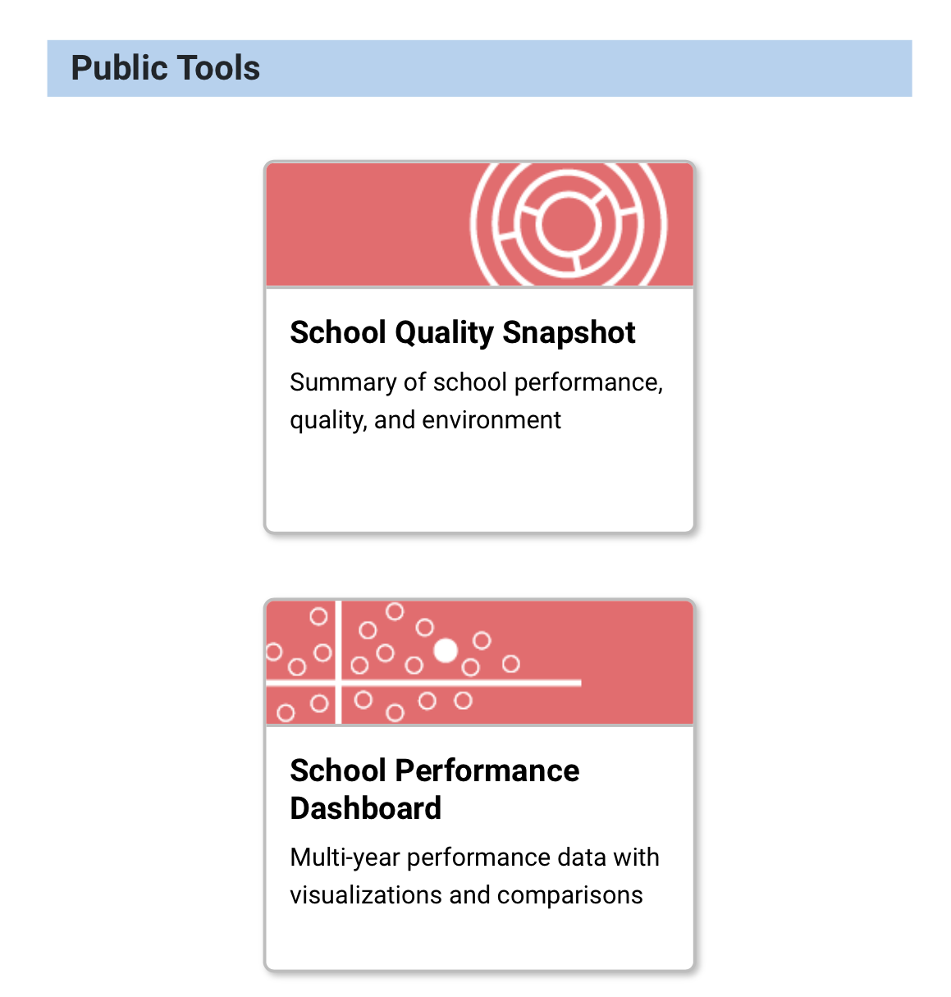
Useful Links: NYC Tools Data
https://tools.nycenet.edu/
School Quality Snapshot
A report that contains background info and data for each school
Updated to 2022-2023 SY
School Performance Dashboard
View school data all in one place.
Updated to 2022-2023 SY

Slide 64
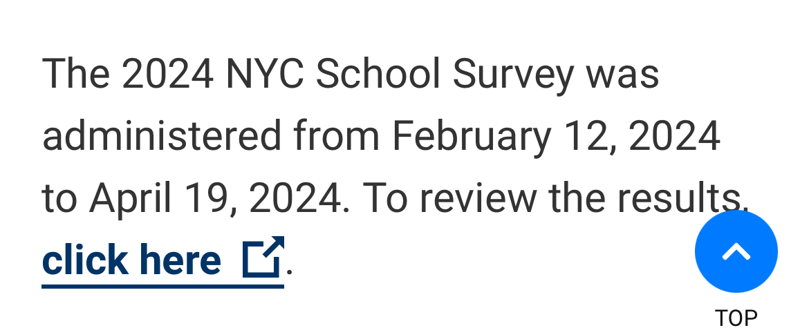
Useful Links: NYC School Survey
2023-2024 Survey results administered by Panorama education can be found:
https://infohub.nyced.org/reports/students-and-schools/school-quality/nyc-school-survey

Slide 65
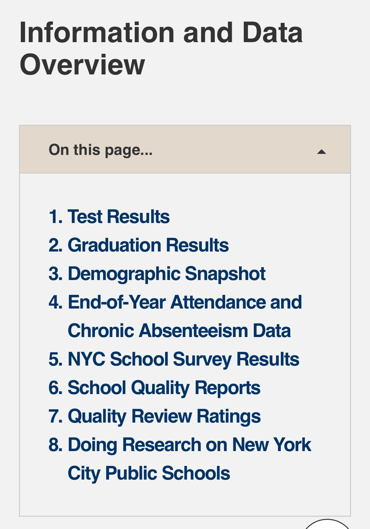
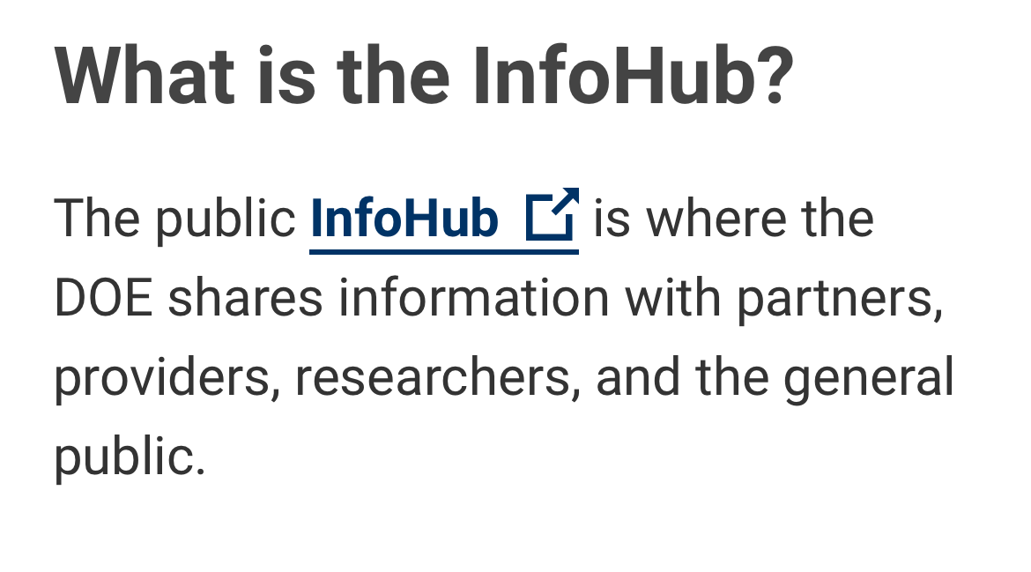
Useful Links: InfoHub
https://infohub.nyced.org/reports/students-and-schools/school-quality/information-and-data-overview

Slide 66
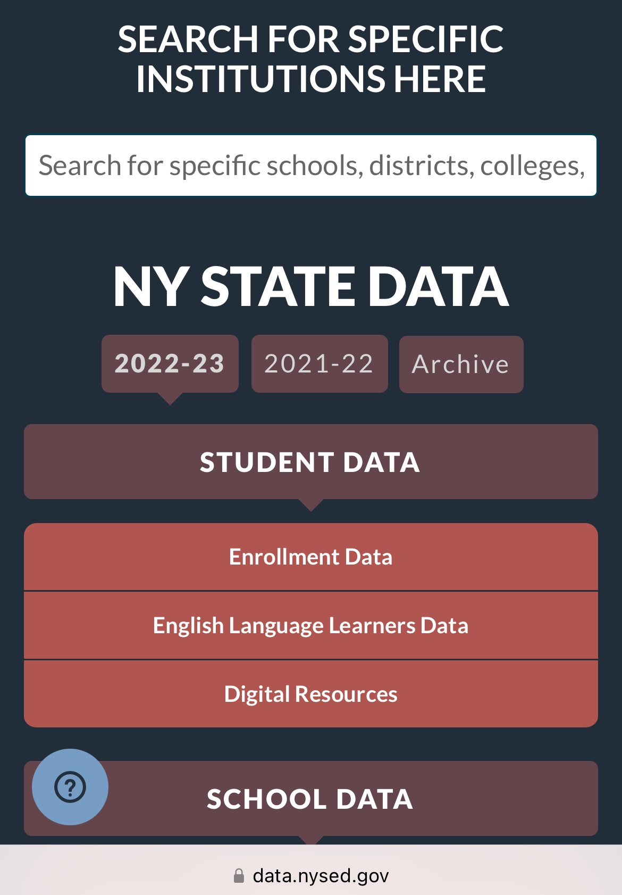
Useful Links: NY State Education Data
https://data.nysed.gov/
Search for school data across NY State
Updated to 2022-2023 SY

Slide 67
Upcoming CEC Meetings
Nov. 12, 6:30 pm on Zoom MS Committee - Parents Helping Parents
  Middle School Applicants Hear from Parents of Current Middle Schoolers in D3
Nov. 19, 6:30 pm on Zoom & In person at WESS - Business & Calendar Mtg.
Visit CEC3.org for more info

Slide 68
Nov. 13th
6-8 pm
Joan of Arc
Application Deadline Dec 20, 2024

Slide 69
Questions?

